Slide 1

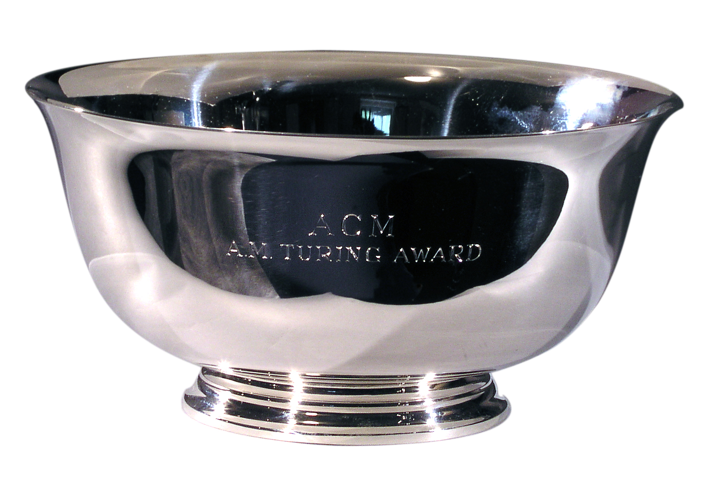
Research Methods in Computing Presentation
By Stephen Gallagher
By Jack Haugh

Slide 2


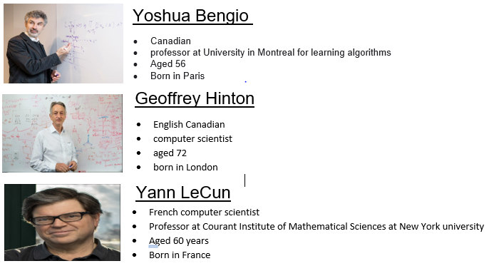
Turing award Winners 2019

Slide 3

Their hard work achievements
Invented the techniques underpinning today’s AI breakthroughs
.
.
.
.

Slide 4

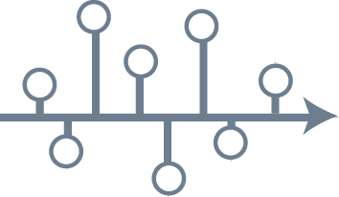
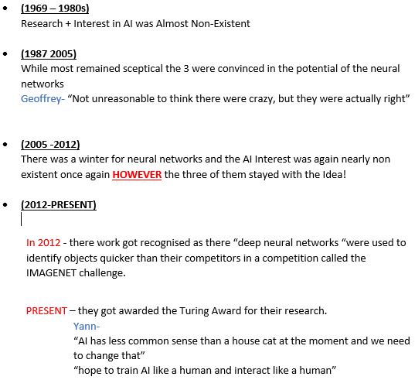
The Turing award winners Timeline

Slide 5

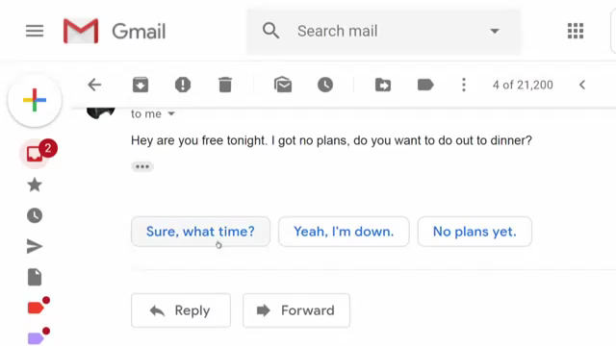
AI EXAMPLE

Slide 6

Any Questions?

